Slide 1
Git
Git is a popular version control system. It was created by Linus Torvalds in 2005, and has been maintained by Junio Hamano since then.
It is used for:
Tracking code changes
Tracking who made changes
Coding collaboration

Slide 2
What does Git do?
Manage projects with Repositories
Clone a project to work on a local copy
Control and track changes with Staging and Committing
Branch and Merge to allow for work on different parts and versions of a project
Pull the latest version of the project to a local copy
Push local updates to the main project

Slide 3
Working with Git
Initialize Git on a folder, making it a Repository
Git now creates a hidden folder to keep track of changes in that folder
When a file is changed, added or deleted, it is considered modified
You select the modified files you want to Stage
The Staged files are Committed, which prompts Git to store a permanent snapshot of the files
Git allows you to see the full history of every commit.
You can revert back to any previous commit.
Git does not store a separate copy of every file in every commit, but keeps track of changes made in each commit!

Slide 4
GitHub
Git is not the same as GitHub.
GItHub is hosting website. It is a website that host git repositories.
GitHub makes tools that use Git.
GitHub is the largest host of source code in the world, and has been owned by Microsoft since 2018.

Slide 5
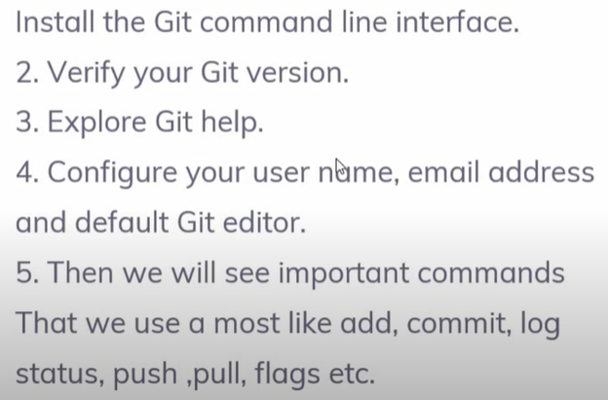
GitHub Installation

Slide 6
GitHub Installation
Open browser: git install
Click on the git SCM website
After installation:: open gitbash and check git is installed or not
Commands:
git
git --version

Slide 7
GitHub Installation
Initialize your directory with git, set your username and email:
Open gitbash
cd D: {go inside D folder}
dir {enter
mkdir int301git
cd int301git
Check status
git status
<not a git repository…. Git is not initialized on this directory>

Slide 8
GitHub Installation
Initialize this directory as git
<while being into ‘int301git’ directory, run command>
git init
Set global name and email in git config file:
Initialize your directory with git, set your username and email
git config --global user.name “manjot”
git config -- global user.email “manjot.28925@lpu.co.in”

Slide 9
GitHub Installation
To verify name and email added or not?
git config --global user.name
git config --global user.email
Edit config file and update name or email:
git config --global --edit
esc :wq
Help from git
git help

Slide 10
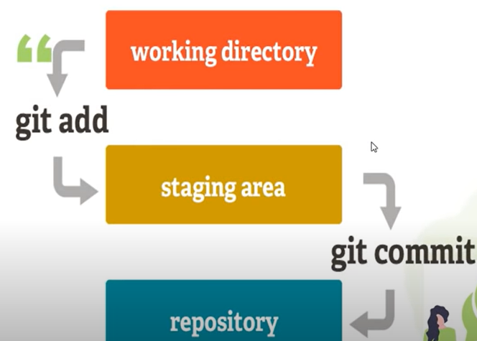
GitHub
int301git
The area where git starts tracking your directory

Slide 11
GitHub Installation
Open Gitbash
cd int301git
touch index.html
check by typing dir command
<write into index.html through bash>
notepad index.html {can use nano as well}
hello <ctrl+s save>
git status
< no commit yet because file is not in staging area yet >

Slide 12
GitHub Installation
Add the file
git add index.html
OR
git add . <no need to add files individually, dot will cover all>
git status

Slide 13
GitHub Installation
Commit
git commit -m ‘this is first commit’
Updates are now in repository.
git status <work area clean>
git log
or git log --oneline

Slide 14
GitHub
GitHub is code hosting platform for version control and collaboration.
It lets you and others work together on projects from anywhere.
Go to github.com and create your account there.
create a new repositor

Slide 15
GitHub
Git remote
git remote add origin <link >
git remote –v
git push –u origin master
refresh online

Slide 16
GitHub
Open file again
notepad index.html
add some text
git add .
git commit –m ‘second addition’
git log --oneline
git push –u origin master

Slide 17
GitHub Branch
Branch in git
A branch will allow making a "copy" while not affecting the original branch
The branch is a copy of the original file.
Open gitbash
cd to your PWD initialized as git
cd D:
cd int301git
git status

Slide 18
GitHub Branch
check for branch:
git branch
{suppose file has 10 lines of code }
keep first 2 line written in file and branch must delete line 3 onwards and add a new line, task is done.

Slide 19
GitHub Branch
Create a new branch
git branch local_branch
git branch
Access the branch , go to local branch
git checkout local_branch
notepad index.html and delete all fines from line 3 and add a new line...task is done by manjot

Slide 20
GitHub Branch
notepad index.html
git status
git add .
git status
git commit -m 'task done by manjot user'
git push -u origin local_branch
refresh online and check

Slide 21
GitHub Branch
To go from one branch to the other
git checkout master
cat index.html
Merge local code to the original code
git merge local_branch
git push -u origin master
refresh online

Slide 22
GitHub clone repository
Git clone: used to create a local copy of a remote repo.
When to use?
No local repository is there.
Suppose you want to access someone else’s project, then you clone that project to get a local copy on your system.
If local folder is not initialized as git repository, then use git clone to access any project → then that project will be linked/put in that local directory.
Later you need not to initialize that folder as local repo.

Slide 23
GitHub clone repository
Open gitbash and
cd D:
mkdir new_clone_git
cd new_clone_git
git status
Now, goto github.com and open any project, ON RHS: clone button
Click and copy HTTPS link

Slide 24
GitHub clone repository
Back to gitbash and
cd new_git_clone
git clone <paste that https clone link here>
Now go to D drive on your machine and check file in new_git_clone folder.
goto this folder and run git status command

Slide 25
GitHub Undo changes
At gitbash
notepad index.html
Make some changes to the file.
git add .
Now run
git checkout -- index.html
It Undo uncommitted changes

Slide 26
GitHub Undo changes
If git checkout – doesn’t work then use git revert
a. Get commit id by using ‘git log’ command
b. git revert <paste that git commit id here>

